Slide 1
Measuring Metal Release Rate from an Arsenopyrite Sample
Chemistry of Metal
Sulfide Minerals

Slide 2
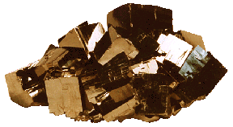
Sulfide Minerals
Pyrite and Marcasite (FeS₂)
Arsenopyrite (FeAsS)
Covellite (CuS)
Chalcopyrite (CuFeS₂)
Galena (PbS)
Wurtzite, Sphalerite (ZnS)
Pyrite (FeS₂)
“Fool’s Gold”
Found near metal ore and coal deposits
Exposure to air and water causes oxidation and subsequent dissolution
Sulfuric acid produced
Metals leached from surrounding minerals
} Acid Mine Drainage

Slide 3
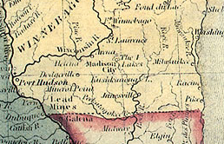
Wisconsin Territory, 1836
Notes:
The names of places such as Galena and Mineral point reflects those part of the history of

Slide 4
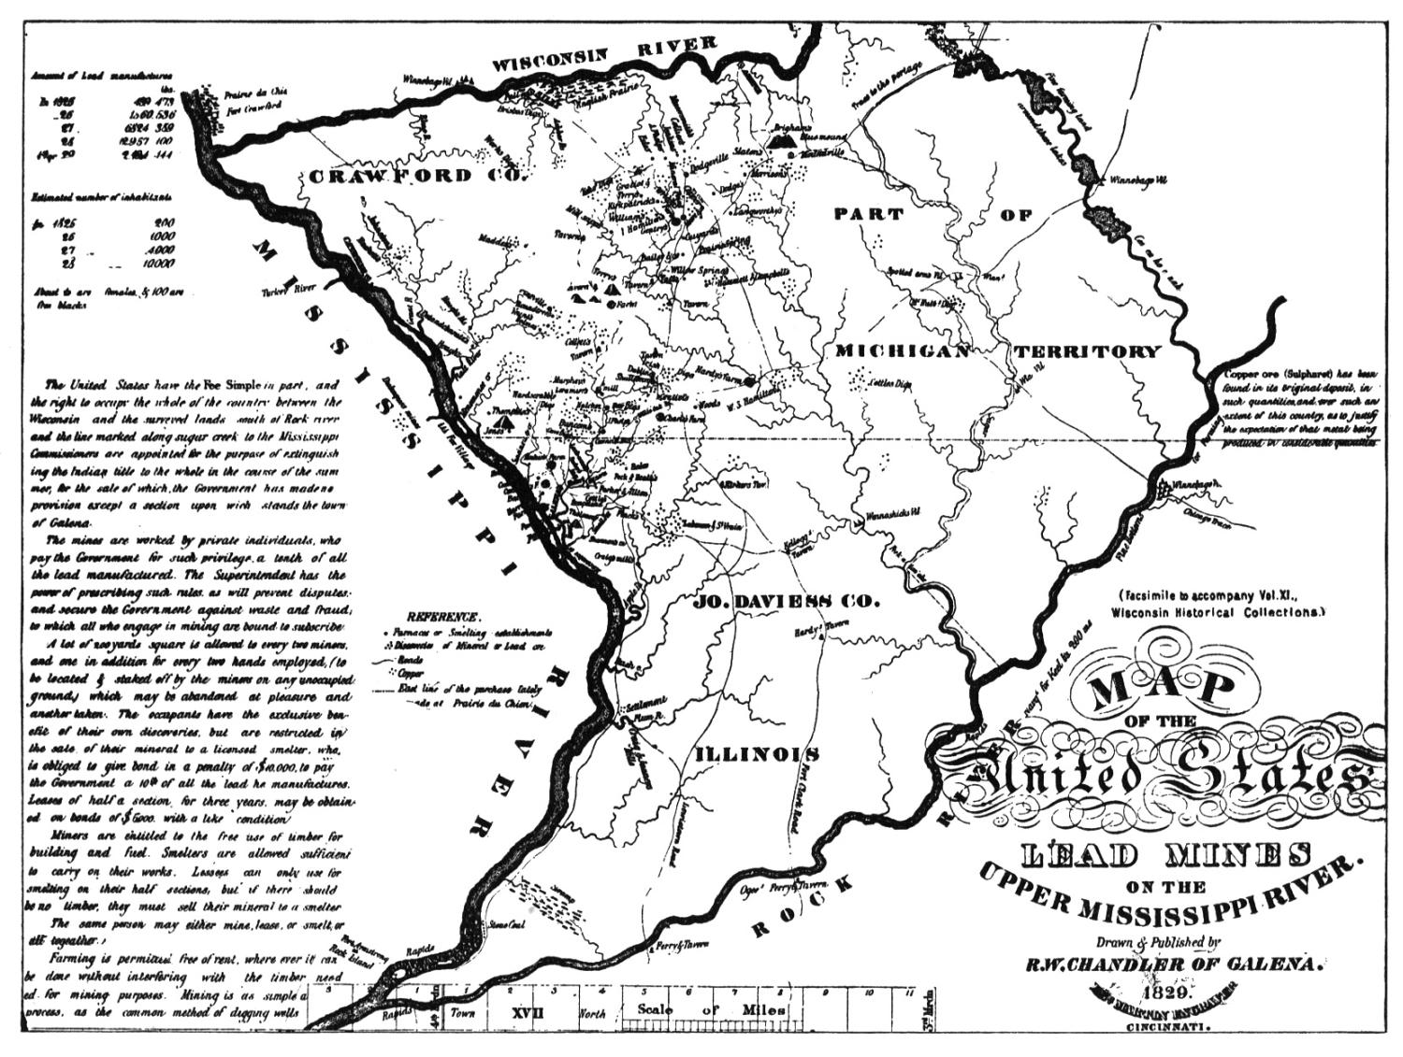
Lead Mines in Wisconsin-Illinois, 1829

Slide 5

Wisconsin State Flag
A miner and a pile of lead cannonballs
feature prominently in the Wisconsin flag

Slide 6
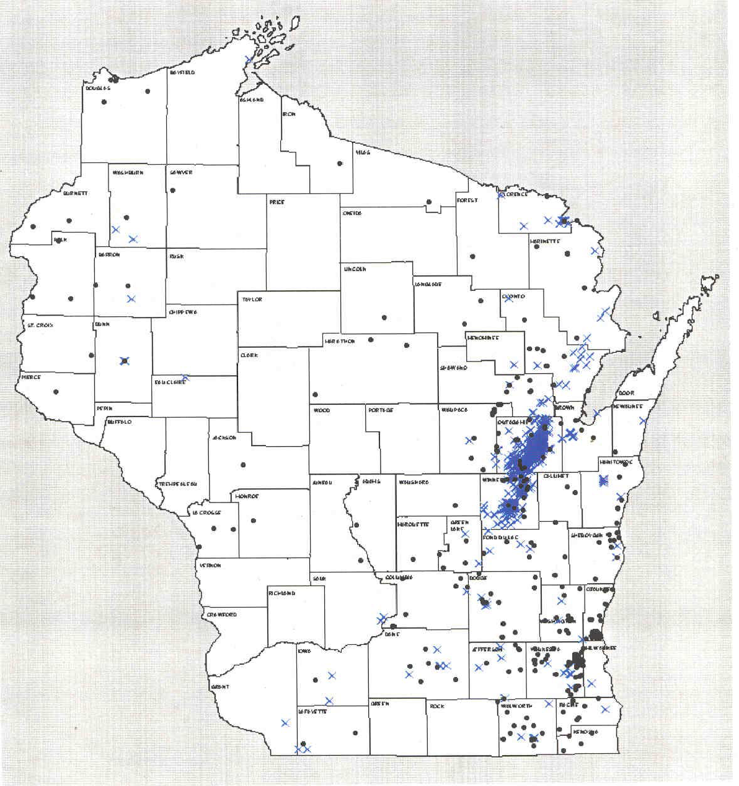
Wells with [As] > 5 ppm in Wisconsin
Green Bay
Appleton
Oshkosh
Fond du Lac
Madison
Milwaukee

Slide 7
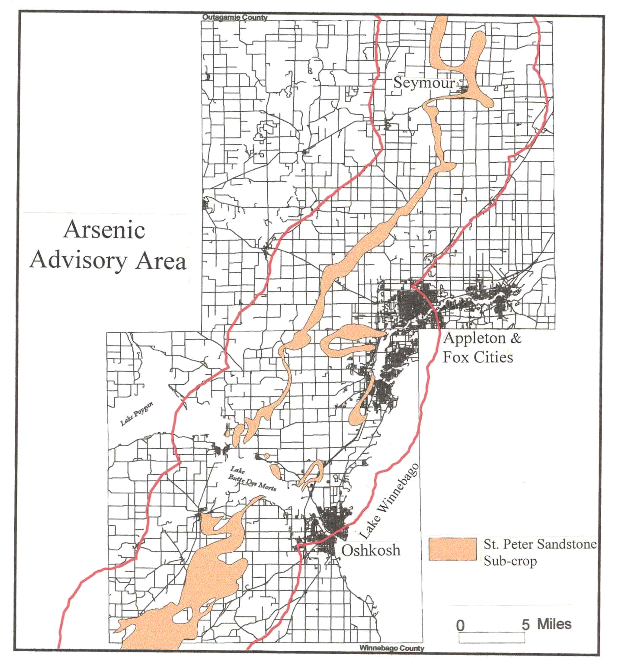

Slide 8
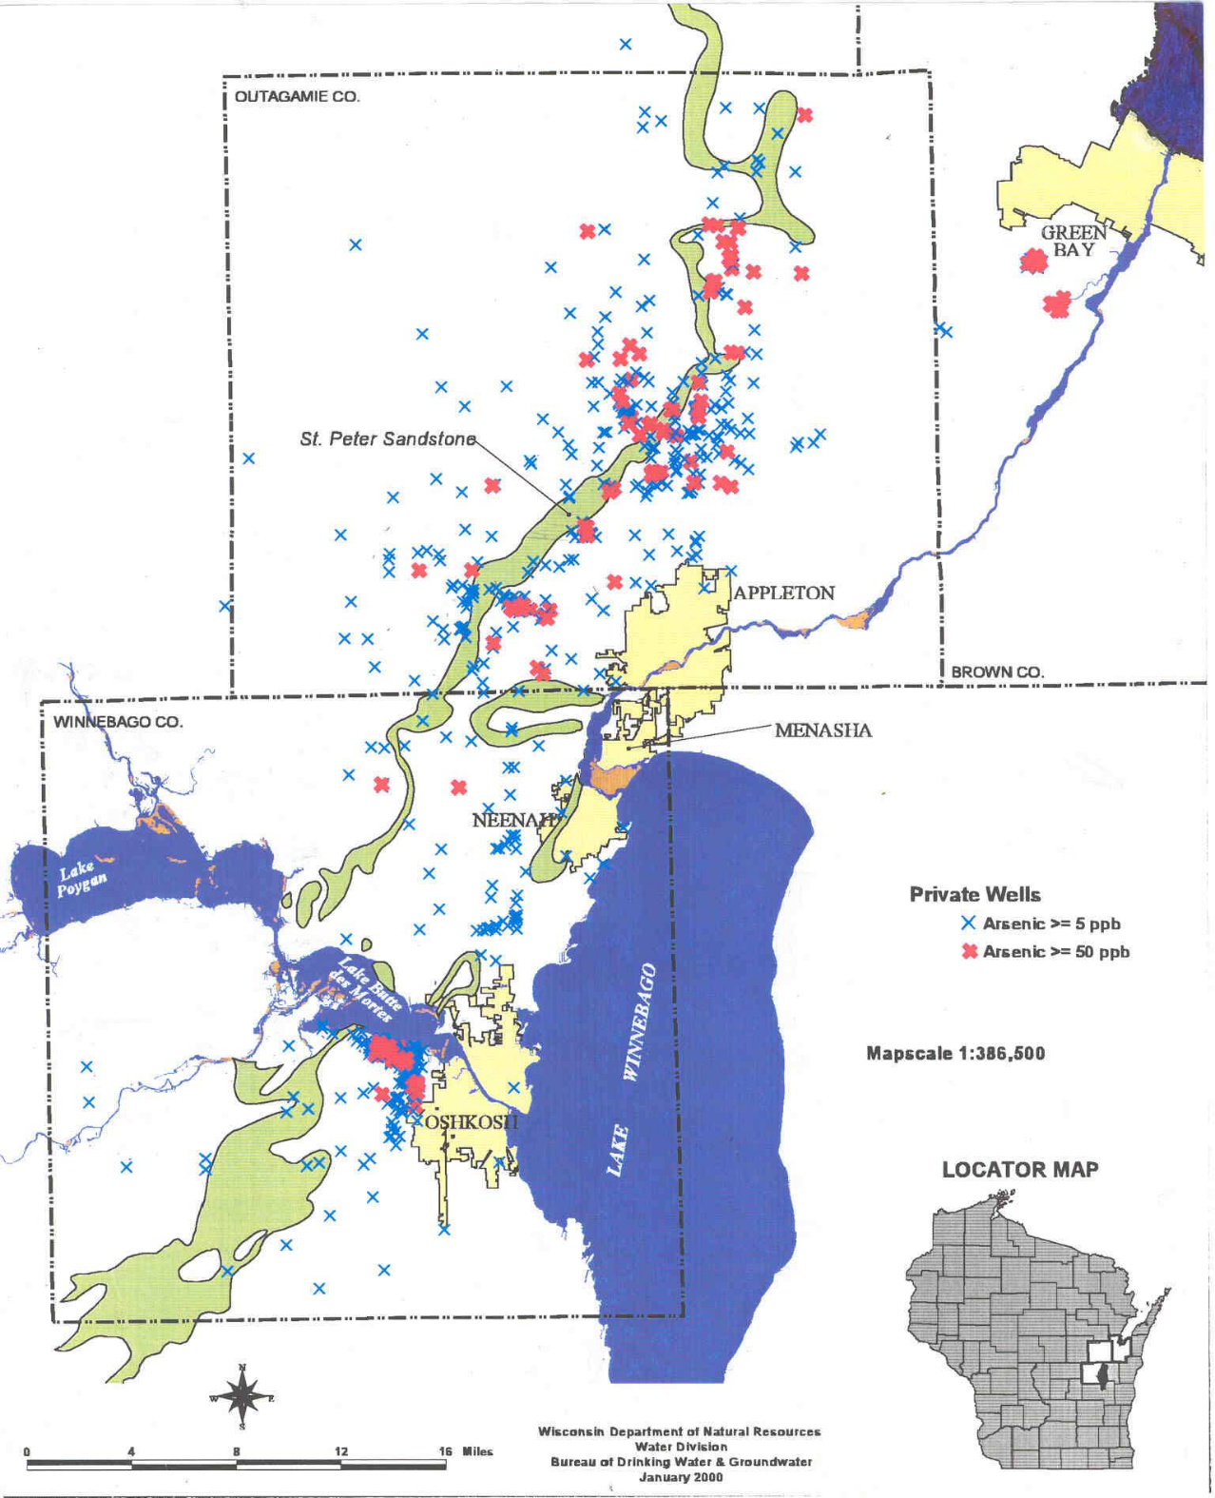

Slide 9
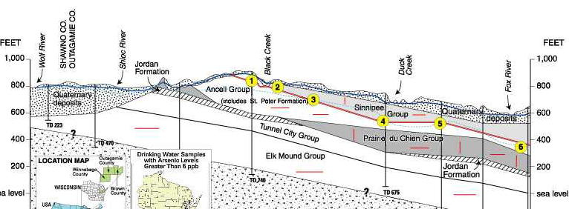
Fox valley arsenic problem: Example
Well was constructed in 1977. In 1990, homeowners reported that water was irritating their skin, had a metallic taste, and was deteriorating plumbing fixtures. The Wisconsin DNR found that…
[As] > 4300 ppb
[Cr]=84 ppb
[Cd]=220 ppb
[Ni]=11,000 ppb
[Pb]=400 ppb
pH=2.05

Slide 10
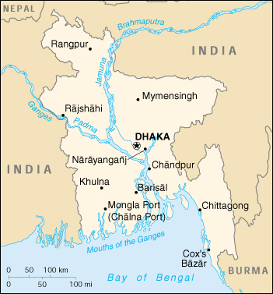
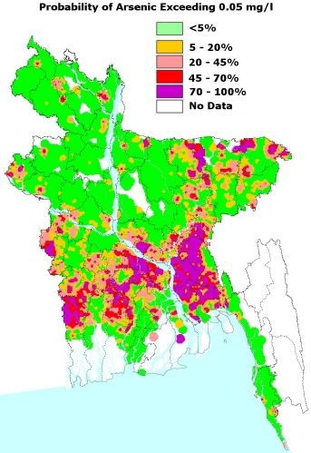
Arsenic Poisoning in Bangladesh
Estimated that ~65 Million people are exposed to high As concentrations from naturally-occuring arsenopyrite

Slide 11
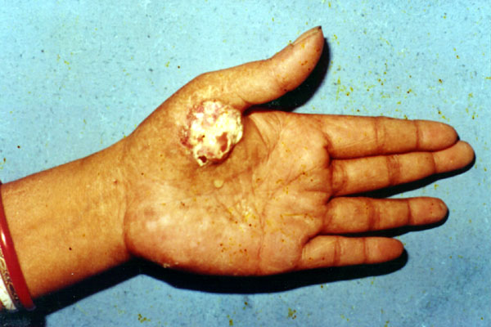

Arsenic Poisoning in Bangladesh

Slide 12
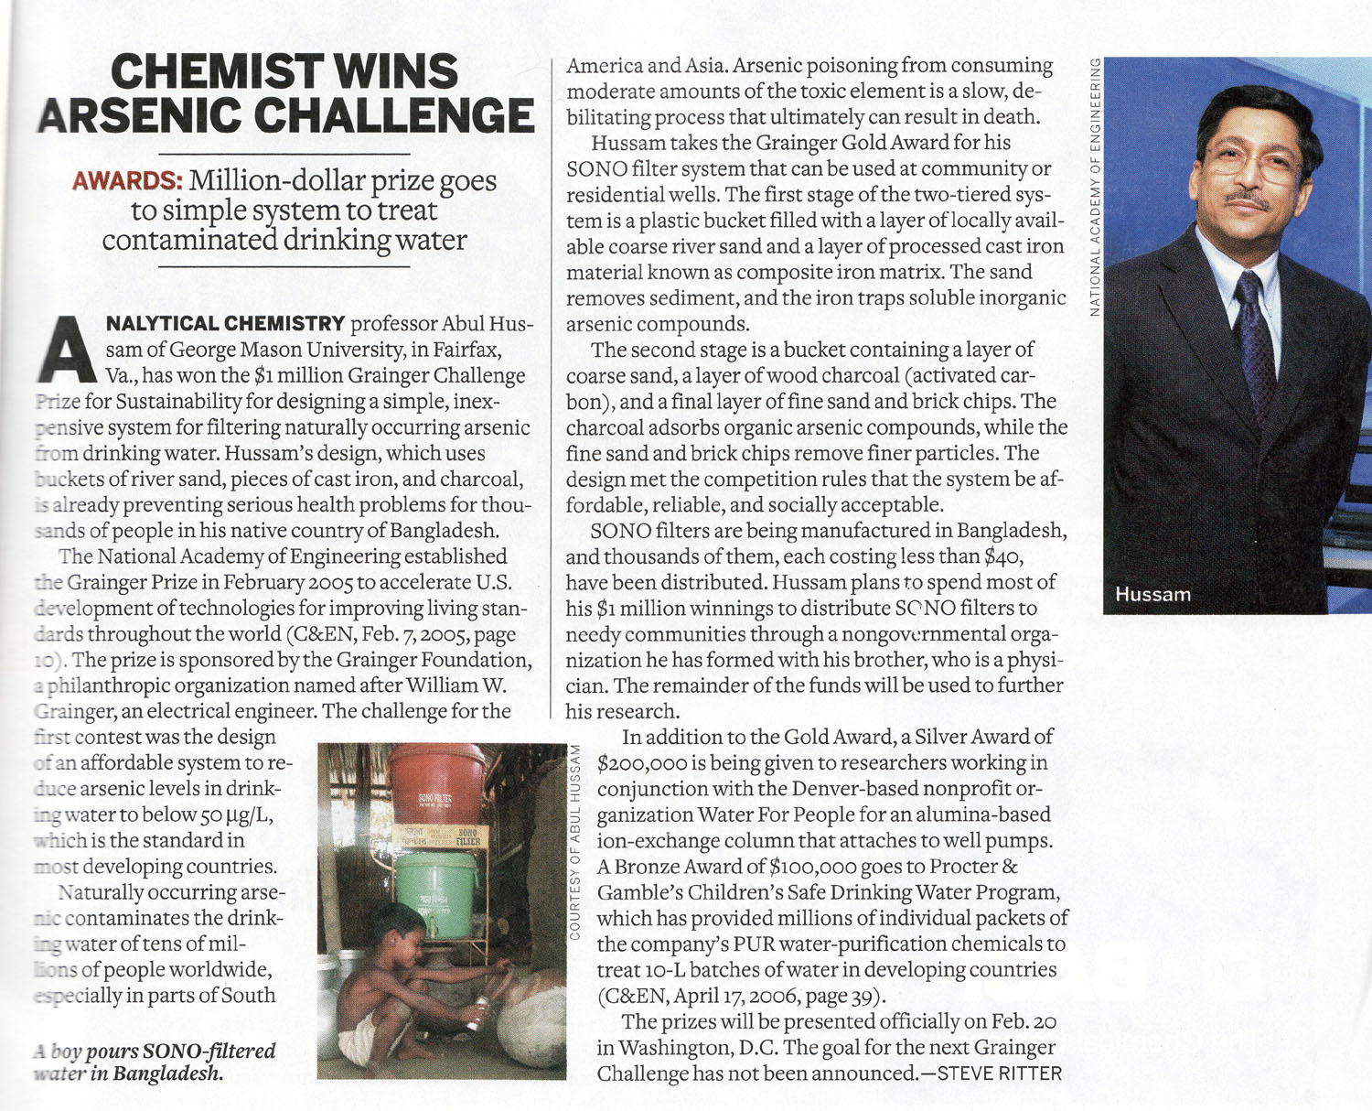
http://pubs.acs.org/cen/news/85/i07/8507prize.html
http://www.washingtonpost.com/wp-dyn/content/article/2007/02/01/AR2007020101874.html

Slide 13
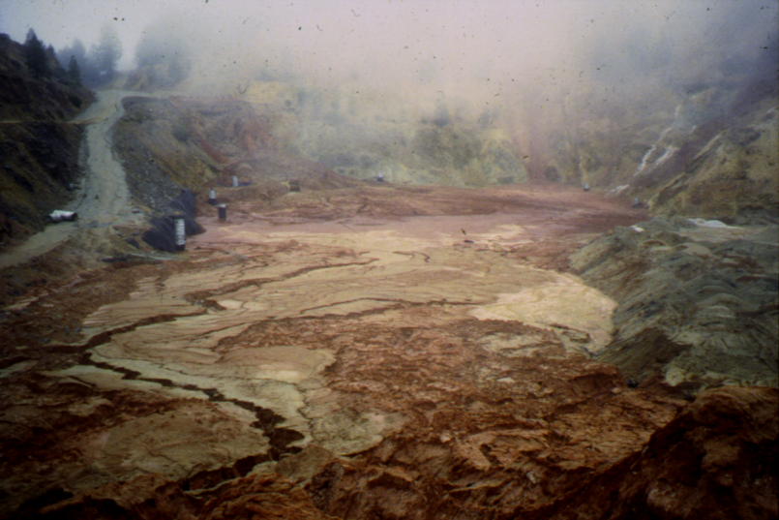
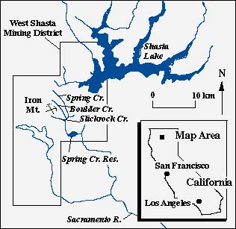
AMD (Acid Mine Drainage)
Sulfide minerals are found at coal and metal deposits. Mining exposes the sulfides to air and water, which results in their oxidative dissolution. This leads to the generation of sulfuric acid and release of heavy metals into water supplies, the process is known as acid mine drainage.
Picture of Iron Mountain Mine, in northern California.
It was mined for iron, silver, gold, copper, and zinc beginning in the late 1800’s till 1962. It was identified by EPA as the largest discharger of toxic metals in US.

Slide 14
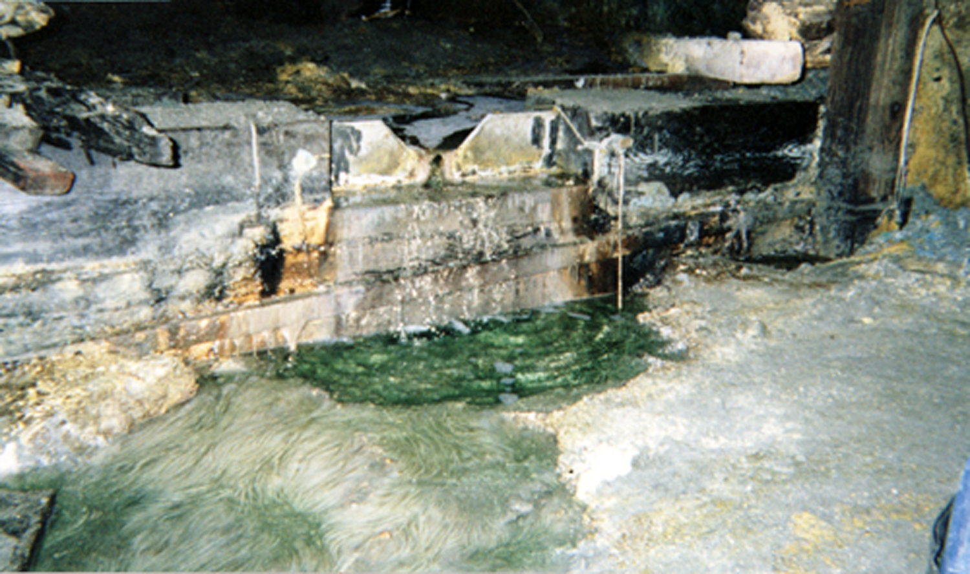
Inside Iron Mountain
pH < 1
High metal concentrations
  Fe > 21,000 mg/L
  Zn > 2000 mg/L
  Cd > 16 mg/L
  Cu > 200 mg/L
  As > 47 mg/L
Temperature ~ 50°C
Green water, due to Cu²⁺ , Ni²⁺

Slide 15
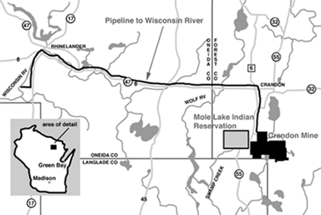
Proposed Crandon Mine
in Northern Wisconsin
55 million tons of ore from a sulfide mineral deposit that is approximately 4,900 feet long, 2,200 feet deep and 100 feet wide. The total surface area disturbed during mine development would be about 550 acres.

Slide 16
Sulfide Minerals
Pyrite and Marcasite (FeS₂)
Arsenopyrite (FeAsS)
Covellite (CuS)
Chalcopyrite (CuFeS₂)
Galena (PbS)
Wurtzite, Sphalerite (ZnFeS)
Pyrite (FeS₂)
“Fool’s Gold”
Found near metal ore and coal deposits
Exposure to air and water causes oxidation and subsequent dissolution
Sulfuric acid produced
Metals leached from surrounding minerals
} Acid Mine Drainage

Slide 17
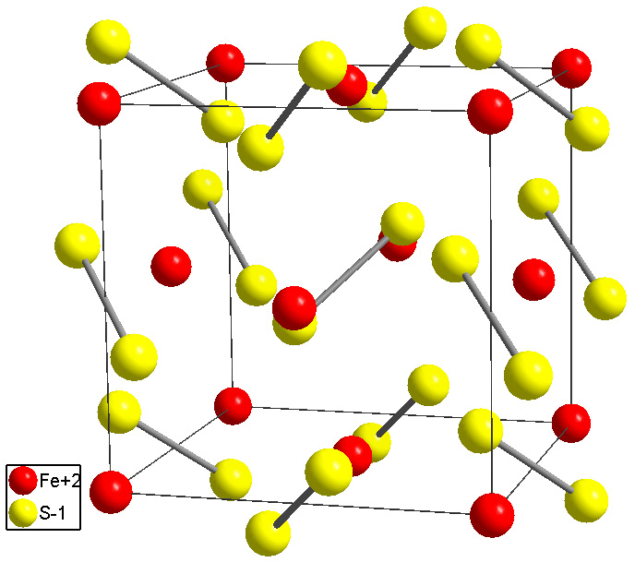
What is known about metal sulfide dissolution?
Pyrite (FeS₂) - most abundant sulfide- model system
Used as a model system for understanding metal sulfide chemistry.
Pyrite: Similar crystal structure to NaCl (Alternating positive Fe²⁺ with S₂⁻² “dumbbells”)
How does pyrite react?

Slide 18
What is known about metal sulfide dissolution?
Fe²⁺ is stable in solution, but S⁻¹ (and As⁻¹) are not
Implication: All metal sulfide reactions involve oxidation of the sulfur and/or arsenic species
The balanced equation:
FeS₂+ 14Fe³⁺+ 8H₂O =>15Fe²⁺+ 2SO₄²⁻ +16H⁺
23 molecules on left-hand side of the equation !
14 Ferric ions required just to oxidize one FeS₂
We can not realistically expect a reaction to involve simultaneous collision of 23 reactants!
Implication:
Reaction must proceed through a series of steps.
What are they, and where do they occur (surface or in solution?)

Slide 19
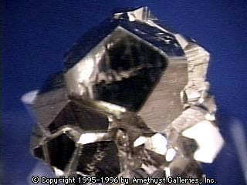
What is the oxidizer?
There are two general pathways for pyrite dissolution at pH<3:
FeS₂ + 7/2 O₂+ H₂O => Fe²⁺ + 2SO₄²⁻ + 2H⁺ (1)
FeS₂+ 14Fe³⁺+ 8H₂O =>15Fe²⁺+ 2SO₄²⁻ +16H⁺ (2)
While O₂ and Fe³⁺ are two competing oxidants, isotope studies show that oxygen in sulfate comes mainly from water. This shows that Fe³⁺ as the direct oxidant, and O₂ probably regenerates Fe³⁺ through:
Fe²⁺+1/4O₂+H⁺ => Fe³⁺+1/2H₂O
[Taylor, B.E.; Wheeler, M.C.; Nordstrom, D.K. Geochim. Cosmochim. Acta 48, p2669-2678.]

Slide 20
Catalytic cycling of ferric ion
xFe³⁺
Fe³⁺
xFe³⁺
FeS₂
FeAsS
FeS₂
FeAsS
Solution
reaction
O₂
Surface
reaction
O₂
yFe²⁺
(x+1)Fe²⁺
Fe²⁺
Oxygen affects reaction by regenerating Fe³⁺ in solution.
Oxygen does not directly react at the surface!

Slide 21
How does the sulfur get oxidized?
Sulfur oxidation states:
S⁻¹ (or S₂⁻² ) in mineral (Sulfur = -1 oxidation state)
S₈ (elemental sulfur) (Sulfur= 0 oxidation state)
S₂O₃²⁻ Thiosulfate (Sulfur = +2 oxidation state)
SO₃²⁻ Sulfite (Sulfur = +4 oxidation state)
SO₄²⁻ Sulfate (Sulfur = +6 oxidation state) --- The final product
Note that elemental sulfur (S₈) is not soluble in water
One possibility (out of many):
FeS₂ + 6Fe³⁺ + 3H₂O ------7Fe²⁺ + 6H⁺ +S₂O₃²⁻ Thiosulfate as intermediate on surface
S₂O₃²⁻ + 8Fe³⁺ + 5H₂O ------ 2SO₄²⁻ + 8Fe²⁺ + 10H⁺ Oxidation of thiosulfate to sulfate
in water

Slide 22

“Local” Dissolution Model
Moses and Luther proposed that in low pH solution, the electron
transfer occurs between the surface and the hydrated ferric ion, this
cycle repeats until the oxidized sulfur compounds leaves the surface.
e⁻
e⁻
Fe
O
O
Fe
Fe
O
O
S
S
S
S
O
S
O
S
S
S
S
S
Fe
Fe
Fe
Fe
Fe
[Moses, C.O.; Nordstrom, D.K.; Herman, J.S.; Mills, A.L. Geochim. Cosmochim. Acta 51, p1561]
[Luther, G.W. Geochim. Cosmochim. Acta 51, p3193]

Slide 23
FeS₂ + 14Fe³⁺ + 8H₂O ------15Fe²⁺ + 16H⁺ +2SO₄²⁻ Sulfate as end product
Break down into two steps:
FeS₂ + 6Fe³⁺ + 3H₂O ------7Fe²⁺ + 6H⁺ +S₂O₃²⁻ Thiosulfate produced at surface
S₂O₃²⁻ +8Fe³⁺ + 5H₂O ------8Fe²⁺ + 10H⁺ +2SO₄²⁻ Thiosulfate to sulfate oxidation
2Fe³⁺
FeSS
2Fe²⁺
FeS₂
FeAsS
FeSSO
2Fe³⁺
2Fe²⁺
FeSSO₂
2Fe³⁺
FeSSO₃
2Fe²⁺
}
S₂O₃
_{(Thiosulfate)}
7Fe²⁺
S₂O₃ ²⁻
7Fe²⁺+
2SO₄²⁻
8Fe³⁺

Slide 24
Another issue: What is the role of elemental sulfur?
FeS₂ + 2Fe³⁺ →3Fe²⁺ + 2S Elemental sulfur (S₈) as end product
FeSS
2Fe³⁺
3Fe²⁺
Formation of
elemental sulfur is
important because
elemental sulfur
can block ability of
Fe ³⁺ to get to the
Surface !
FeS₂
FeAsS
2S⁰
S₈
Fe³⁺
X
No Reaction!
Elemental sulfur does not appear to be a major intermediate during pyrite oxidation. However, it does appear to be a major product from other sulfides, such as arsenopyrite (FeAsS) and galena (PbS) .

Slide 25
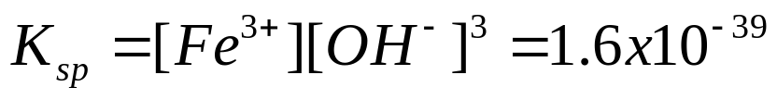
Influence of pH :
FeS₂+ 14Fe³⁺+ 8H₂O =>15Fe²⁺+ 2SO₄²⁻ +16H⁺ (2)
According to “Le Chatelier’s Principle”, increasing [H⁺] (lowering the pH) should push the equilibrium toward the left.
However, the maximum concentration of Fe ³⁺ in solution is controlled by its solubility product
Fe³⁺ + 3 OH⁻ → Fe(OH)₃
If Fe(OH)₃ is present (high pH), then as the pH goes down, the amount of Fe ³⁺ that can stay in solution increases. So, the rate of the reaction increases.
But what effect does H⁺ have at lower concentrations, where
Fe(OH)₃ precipitate does not form?

Slide 26
Removal of Fe³⁺ by precipitation of Fe³⁺ at high pH
Fe(OH)₃ (solid)
OH⁻
xFe³⁺
Fe³⁺
FeS₂
FeAsS
xFe³⁺
FeS₂
FeAsS
Solution
reaction
O₂
Surface
reaction
O₂
yFe²⁺
Fe²⁺
(x+1)Fe²⁺

Slide 27
A Few Potential Variables:
Ferric ion concentration:
Fe³⁺ needed to induce reaction, Fe²⁺ is a product
Total [Fe] increases during reaction
Ferrous ion concentration:
Does concentration of ferrous ion affect reaction rate?
Presence/Absence of oxygen:
Oxygen converts Fe²⁺ to Fe³⁺
Does oxygen have any “direct” Role in the reaction?
pH:
Does pH affect reaction only through solubility of Fe(OH)₃?
Temperature:
Is reaction faster at elevated temp?
“Iron Mountain” produces H₂SO₄ at 40-50ºC.

Slide 28
Goals of the Design Project
Are for you to:
Learn quantitative analysis in the context of a real-life environmental problem.
Learn how to apply the scientific method as you develop hypotheses, design your experiments, and develop your own interpretation.
Understand some of the complexities and uncertainties associated with scientific measurements, especially when working with complex systems and the natural environment.
Learn how to communicate your scientific results, orally and in writing.

Slide 29
What controls the rate?
Ferric ion concentration:
Overall stoichiometry involves large number of Fe3+ ions.
What is the order “n” of the reaction? (Rate ~[Fe³⁺]^{n})
Ferrous ion concentration:
Electrochemical potential of an electrode is controlled by ratio of concentrations (Fe³⁺ / Fe²⁺). Even though the reaction is strongly “downhill”, it is still possible for a product to strongly affect the rate.

Slide 30
What controls the rate?
Presence/Absence of oxygen:
Oxygen converts Fe²⁺ to Fe³⁺
Does oxygen have any “direct” Role in the reaction?
pH:
Does pH affect reaction only through solubility of Fe(OH)₃, Le Chatelier’s principle says that since H⁺ is a product, lowering the pH should shift the equilibrium toward the reactants. However, the system is far from equilibrium…
Temperature:
Is reaction faster at elevated temp?
“Iron Mountain” produces H₂SO₄ at 40-50ºC.

Slide 31
How can you learn about the mechanism of a reaction?
1) Measure the rate of reaction !
Determine how the rate of reaction depends on certain key variables such as [H⁺], [Fe ³⁺ ],
Presence/absence of oxygen, etc.
Kinetic measurements typically give good information about the slowest step(s) in a chemical reaction. Those are usually the steps that of the most interest.

Slide 32
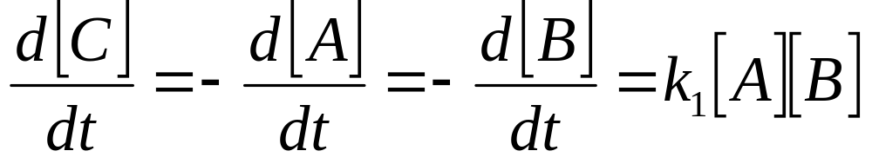
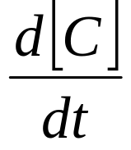
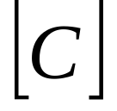
Kinetics of chemical reactions:
The simplest example:
A + B →C
Rate constant
Slope of this line is the rate =
Rate when [A] is higher
Rate when [A] is lower
time

Slide 33
The simplest example:
A + B →C
Rate constant
Slope of this line is the rate =
time

Slide 34
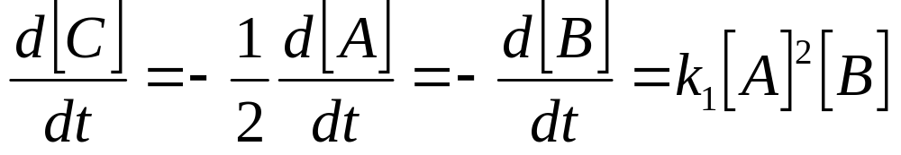
Kinetics of chemical reactions:
More complicated:
2A + B →C
This reaction is “second-order” in [A] and “first-order” in [B]
For this mechanism, the slope of this line is the rate should be proportional to [A]²
time
Can determine the “order” of a reaction, and how many atoms
Are involved in the rate-determining step, but measuring how the rate changes with the concentration of a reactant

Slide 35
Measure the distribution of products !
Rate 1
Rate 2
Rate 3
FeAsS -→ Fe ²⁺ + S₈(surface) → S₂O₃ → SO₄
S₂O₃
S₈
SO₄
By measuring the concentration of each intermediate as a function of time, we can develop a kinetic model that will tell us about the mechanism of the reaction

Slide 36
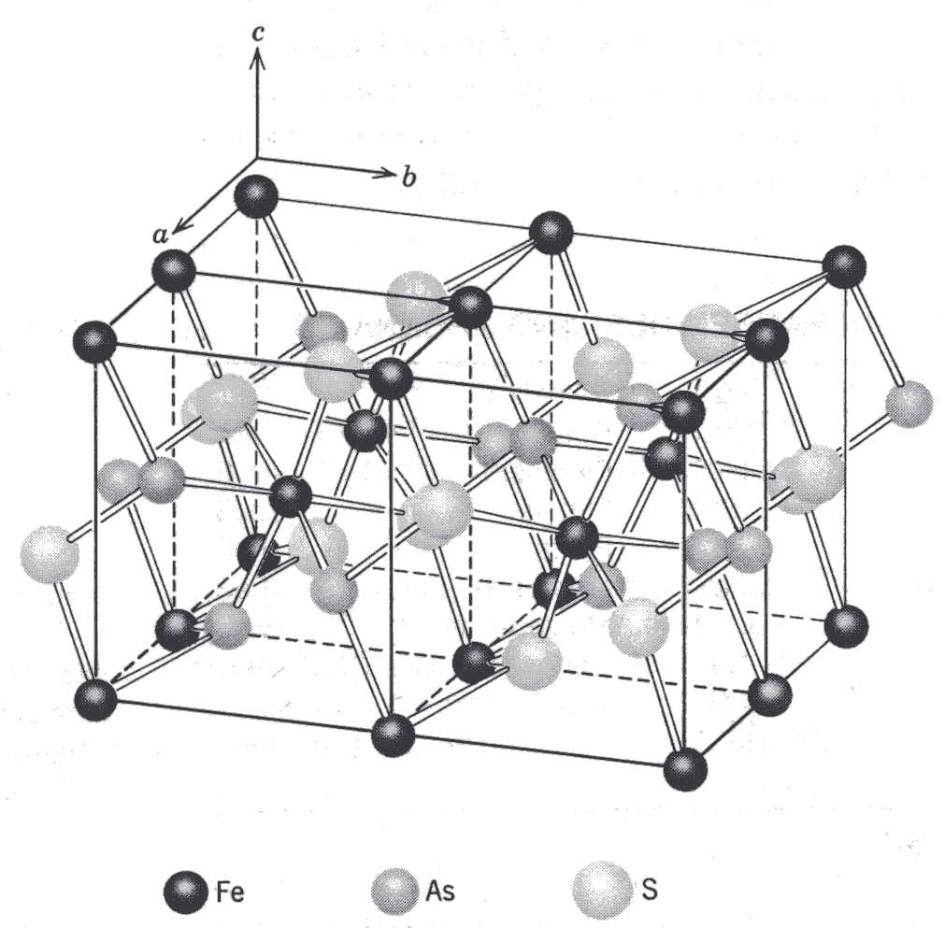
Arsenopyrite (FeAsS)

