Slide 1
Announcements
Complete your course evaluation!
Monday May 14th is a review session
Wednesday May 16th is the last exam (normal class time and place)
Notes:
Discuss how to make your evaluations count.

Slide 2
Previously…
We looked at the details of how analytes (solutes) generally behave during chromatography
  Retention time and order
  Resolution
  Band broadening
  The effects of different experimental conditions
Notes:
1 min, 1 min total

Slide 3
Today…
Gas chromatography (GC)!
Mini-lecture followed by problem solving
SLO1: Describe the basic components of a GC instrument and a flame ionization detector
SLO2: Name and explain the factors that affect analyte retention and resolution in GC experiments.
SLO3: Describe temperature programming and its benefits.
Notes:
1 min, 1 min total

Slide 4

Ch 24 – GC video

Slide 5
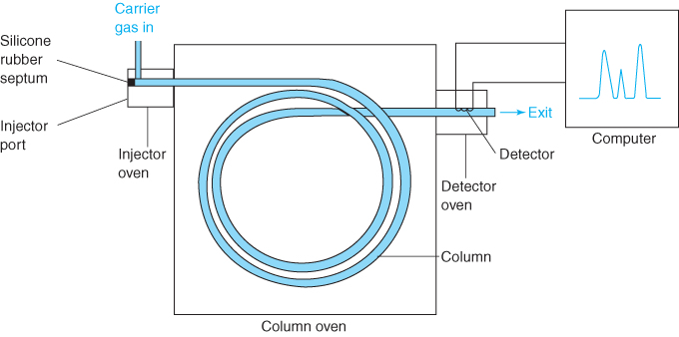
This is the general setup of a gas chromatograph:
Sample Inlet
Detector
Column
Notes:
3 min, 5 min total

Slide 6
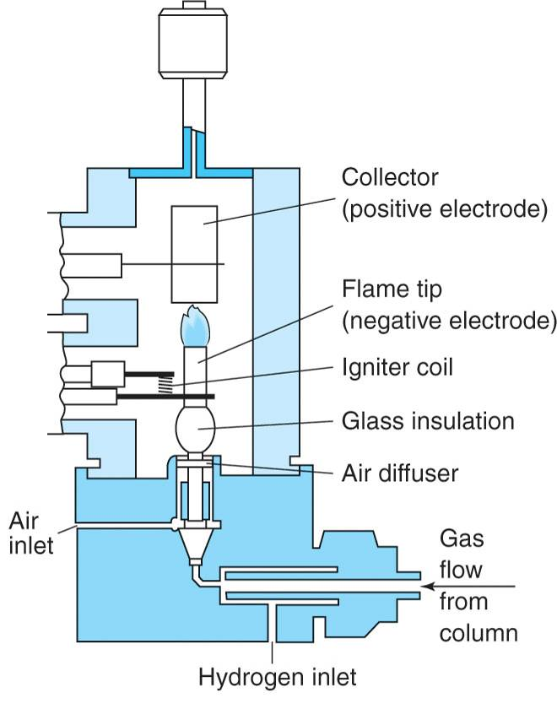
Flame Ionization Detector (FID):
As organic analytes elute off the column and are combusted, CHO⁺ ions and electrons are generated and cause current flow between cathode and anode
Responds to most organic compounds (but not NO, O₂, N₂, CO₂)
Sensitive (LODs in ng range)
Notes:
4 min, 11 min

Slide 7
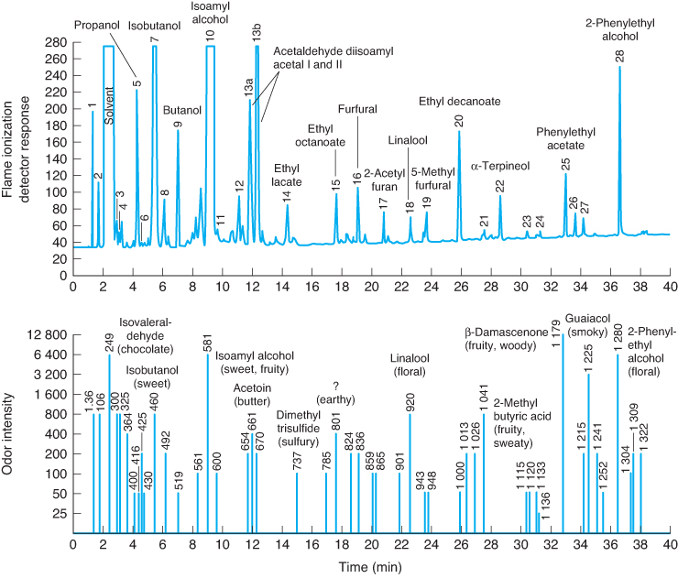
Tequila analyzed by GC using FID (top) and olfactory detection (bottom)
Notes:
Tequila spectrum using FID (top) and olfactory detection (bottom)

Slide 8
Worksheet
Each student must fill in a worksheet.
Must be handed in before you leave.
It will be returned to you via Gradescope and will count as your clicker participation today.
The Key for the worksheet will be placed online.

Slide 9
SLO1: Describe the basic components of a GC instrument and a flame ionization detector
SLO2: Name and explain the factors that affect analyte retention and resolution in GC experiments.
SLO3: Describe temperature programming and its benefits.
Notes:
1 min, 1 min total

Slide 10
In summary, we discussed the main factors that influence retention time and resolution in GC experiments:
  Column temperature
  Boiling point of analyte
  Column composition
You should be able to explain how and why these factors influence the retention time and resolution of an analyte.
Notes:
.5 min, 1.5 min total

Slide 11
Conclusions / ToDo / Next Class
Read Chapter 24 section 24-1, and Flame Ionization Detectors in section 24-3
Notes:
1 min, 20 min total

