Slide 1
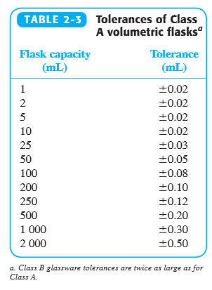
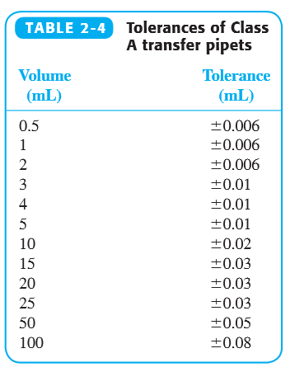
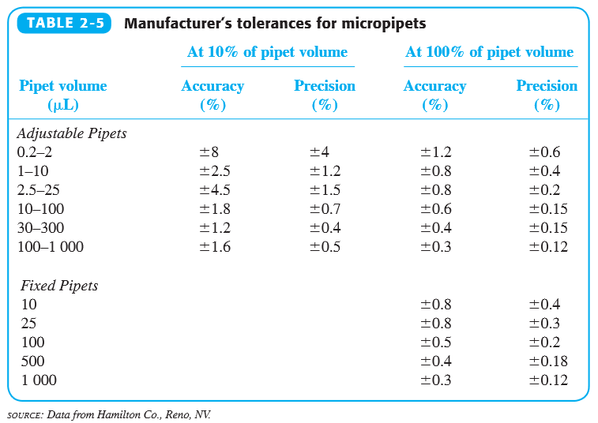
CHEM 215
Practical Exercise in Uncertainty
Learning Objectives:
Apply addition, subtraction, multiplication, and division rules to propagate uncertainty.
Plan how to prepare a solution in lab with optimal accuracy.
Challenge:
You are tasked with preparing 100 mL of a 0.0010 M solution from a 1.0 M stock solution. Develop a plan that minimizes the overall uncertainty in concentration. You have access to Class A volumetric flasks, Class A transfer pipets, and Hamilton micropipets. Plans involving serial dilutions are acceptable. Don’t even think about using beakers or graduated cylinders.
Tables from Harris, Quantitative Chemical Analysis, 9th ed, ch 2

Slide 2
